Slide 1
Estimating the Undiagnosed Fraction:
Implementing the “Testing History” method
Jeanette Birnbaum
presenting on behalf of
Martina Morris, Ian Fellows and Matt Golden
Notes:
Update on this project about …

Slide 2
Overview
Last Year
Developed method
KC analysis
This Year
WA state analysis
Prototype access portal
Future
Refine method
Release to public health depts

Slide 3
The Testing History Method

Slide 4
How many HIV cases are undiagnosed?
Method | Estimate of Undiagnosed MSM (Nat’l) | Considerations
Empirical from NHBS (survey) | 44% | Representative sample? Self-report of status
CDC backcalculation(model) | 19.1% | Need data on time from infection to AIDS Not accessible
Testing history backcalculation (model) | ? | Need data on diagnosis and last negative test (“testing history”)

Slide 5
Reminder: Backcalculation
New diagnoses today…
…are based on infections that occurred in the past
3 infections
10 new cases
1 infection
1 infection
5 infections
Time
2010
2011
2012
2013
2014

Slide 6
Time from Infection to Diagnosis (TID)
3 infections
10 new cases
1 infection
1 infection
5 infections
Time
2010
2011
2012
2013
2014
15 new cases
4 infections
7 infections
4 infections

Slide 7
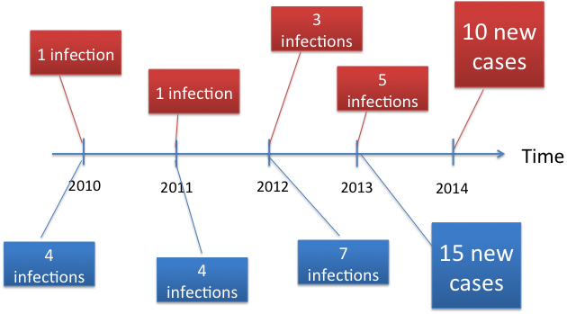
Time from Infection to Diagnosis (TID)
FOR 2013 DIAGNOSES:
TID | Probability
1 year | 7/(7+3) = 0.7
2 years | 4/(4+1) = 0.8
3 years | 4/(4+1) = 0.8

Slide 8
Incidence, TID and Diagnosis
TID | Probability
1 year | 0.7
2 years | 0.8
3 years | 0.8
Cases in 2013 = | (Incidence 2012)*(TID 1 yr ago) + (Incidence 2011)*(TID 2 yrs ago) + (Incidence 2010)*(TID 3 yrs ago)
= | 10*0.7 + 5*0.8 + 5*0.8
= | 15

Slide 9
Backcalculation’s 3 Components
OBSERVED
Cases diagnosed at T
=
Sum of ( *
)
BACKCALCULATE
Incidence at X yrs ago
TID probability for X yrs ago
CAN ESTIMATE

Slide 10
Testing History Backcalculation
Infection window = [date of last negative test, date of HIV diagnosis]
Apply some assumptions to estimate TID
Back-calculate incidence
Calculate undiagnosed as those whose incidence and diagnosis did not occur in the same time period (quarter-year)

Slide 11
Major TID assumptions
TIME OF INFECTION
MISSING TESTING HISTORY
UNIFORM
EXTREME
 | Uniform between last negative test and diagnosis | Right after last negative test
TID for cases with missing data comes from observed data | Base Case | Upper Bound or Worst Case (Obs)
Date of last negative test is imputed as min(age=16, 18 years) |  | Worst Case (Miss)
MISSING AT RANDOM
EXTREME

Slide 12
Minor TID assumptions
For cases who said they NEVER had a negative test
Impute date of last negative test as min(age=16, 18 years)
For cases who gave a date of last negative test > 18 years ago
Reduce to 18 years ago
TID is stationary over time

Slide 13
Implementing the Method

Slide 14
Testing History Data
 | King County (KC) | WA State
N | 1522 | 4744
Years | 2006-2012 | 2005-2013
Sources | eHARS/HIS/PS | eHARS+
Major modes of transmission | MSM | MSM, Heterosexual, Blood/Needle
Missing testing history | 18% | 35% in MSM 44% in all

Slide 15
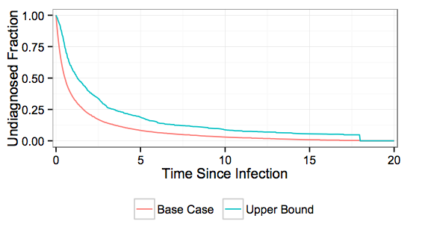
Reminder: TID in KC

Slide 16
Reminder: KC Results
TID Distribution Assumption | Estimated Number of MSM with HIV | Estimated Number of MSM with undiagnosed HIV | Undiagnosed Fraction
Base Case | 5850-5884 | 333-368 | 5.7%-6.3%
Upper Bound/Worst Case (Obs) | 6178-6229 | 662-713 | 10.7%-11.4%

Slide 17
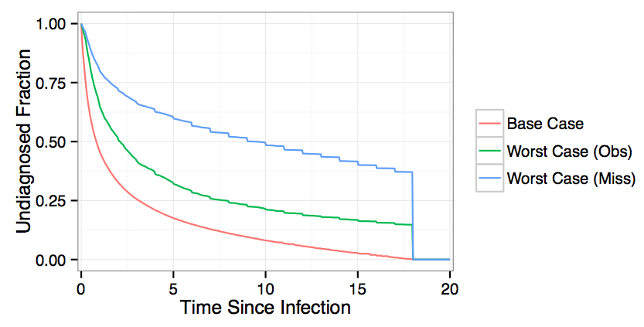
TID in WA State

Slide 18
Results for WA State
TID Distribution Assumption | Estimated Number with HIV | Estimated Number with undiagnosed HIV | Undiagnosed Fraction (2005-2013) | Undiagnosed Fraction (2013)
Base Case | 11306-13688 | 1329-1501 | 9.7%-13.2% | 9.7%
Upper Bound/Worst Case (Obs) | 12758-15013 | 2652-2942 | 17.7%-23% | 17.7%
Worst Case (Miss) | FILL IN |  |  | ABOUT 35%

Slide 19
Key Considerations
Using testing history has pros and cons
Avoid assumptions about testing rates, time to AIDS
Sensitive to missing testing history data
How can we improve our “extreme” assumptions?
Infection occurs right after last negative test
Draw upon data on risk-based testing?
Missing testing history data is missing at random or min(age-16, 18 years)
Better ways to impute missing date of last negative test?

Slide 20
Disseminating the Method

Slide 21
On the Web
https://hivbackcalc.shinyapps.io/HIVBackCalc_App/

Slide 22
References
Slide 4
Chen M, Rhodes PH, Hall IH, Kilmarx PH, Branson BM, Valleroy LA, Centers for Disease C, Prevention: Prevalence of undiagnosed HIV infection among persons aged >/=13 years--National HIV Surveillance System, United States, 2005-2008. MMWR Morb Mortal Wkly Rep 2012, 61 Suppl:57-64.
Hall HI, Frazier EL, Rhodes P, Holtgrave DR, Furlow-Parmley C, Tang T, Gray KM, Cohen SM, Mermin J, Skarbinski J: Differences in human immunodeficiency virus care and treatment among subpopulations in the United States. JAMA internal medicine 2013, 173(14):1337-1344.

